Slide 1
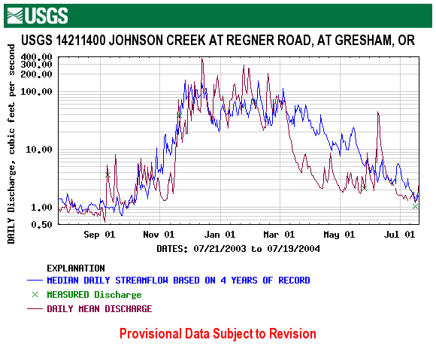
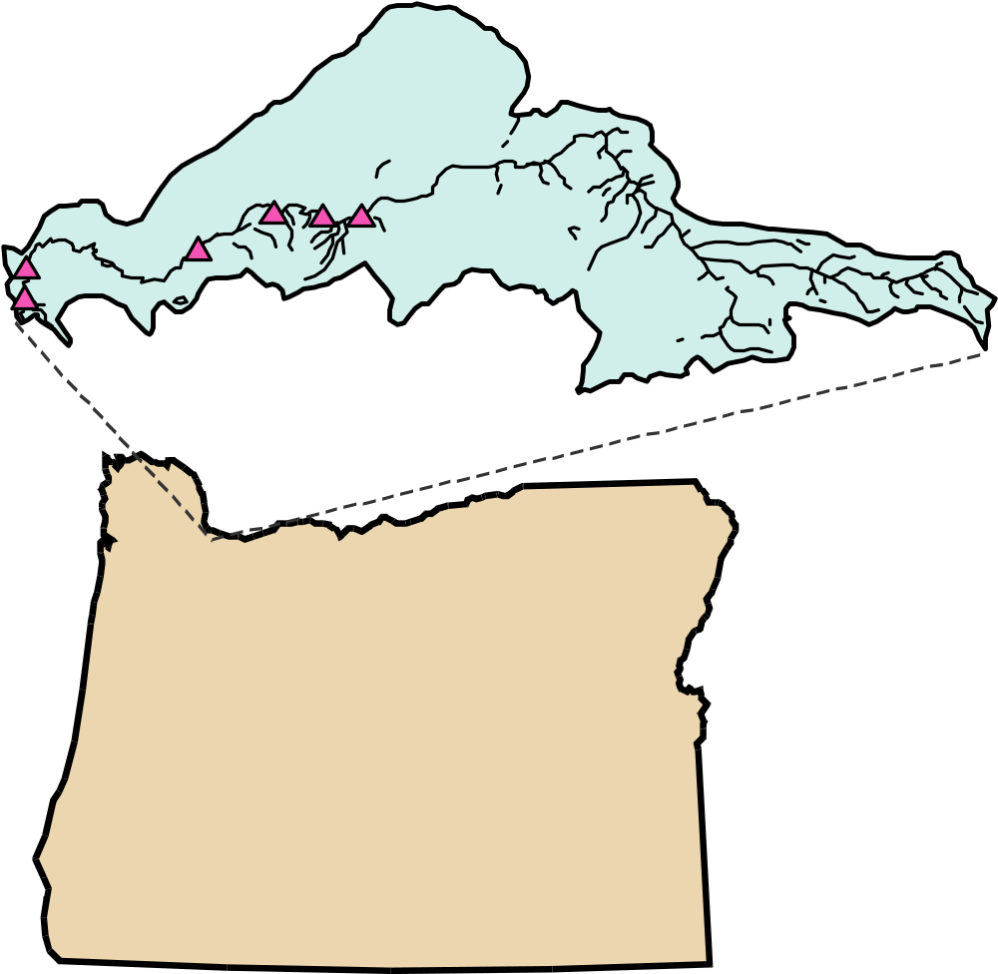
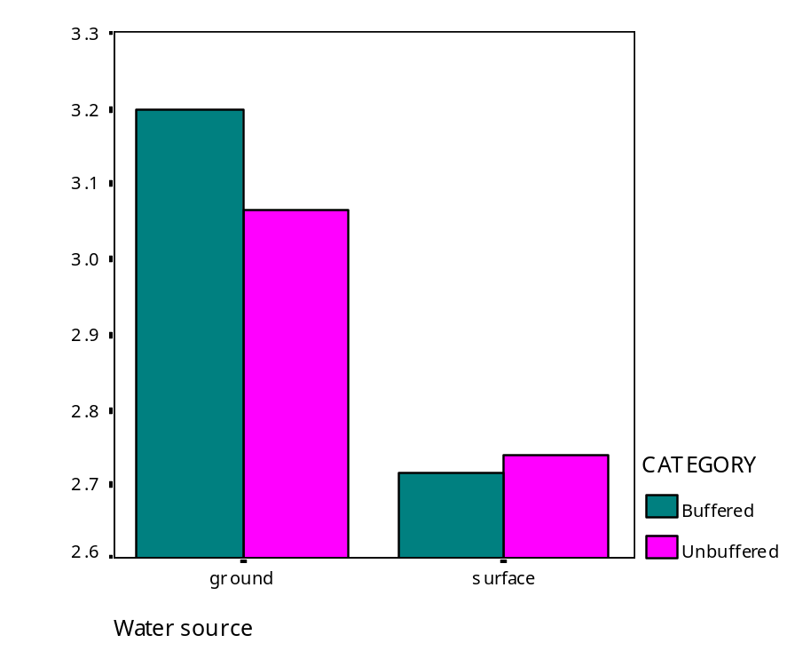
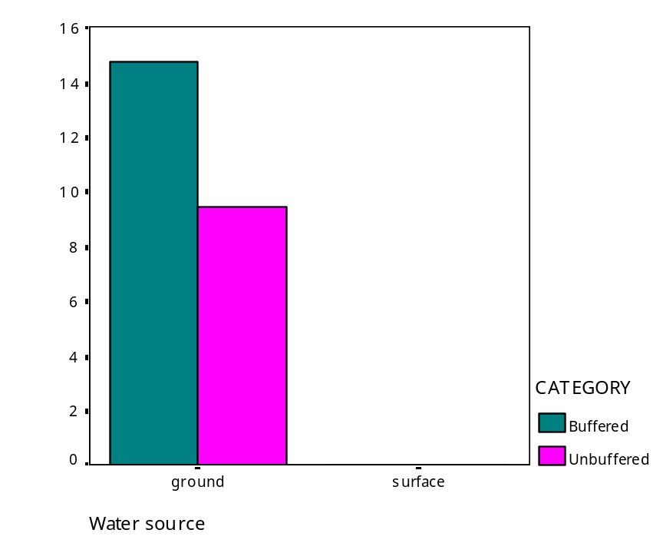
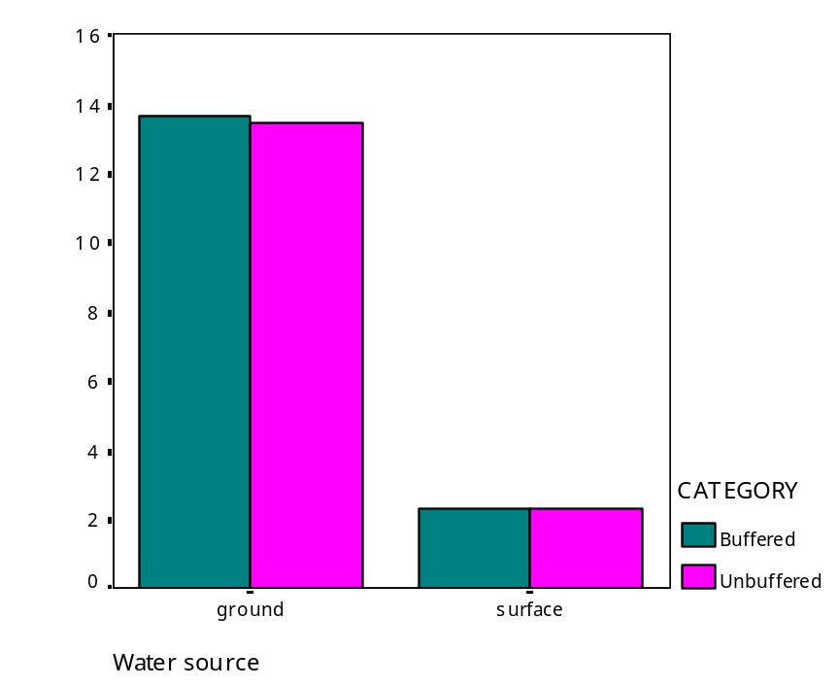
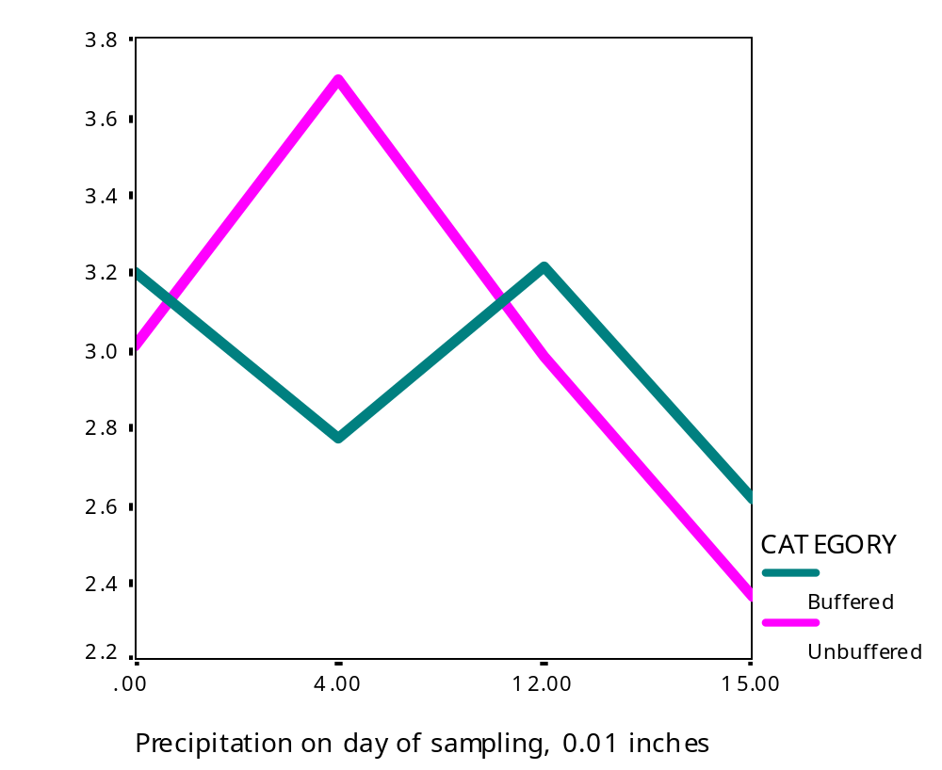
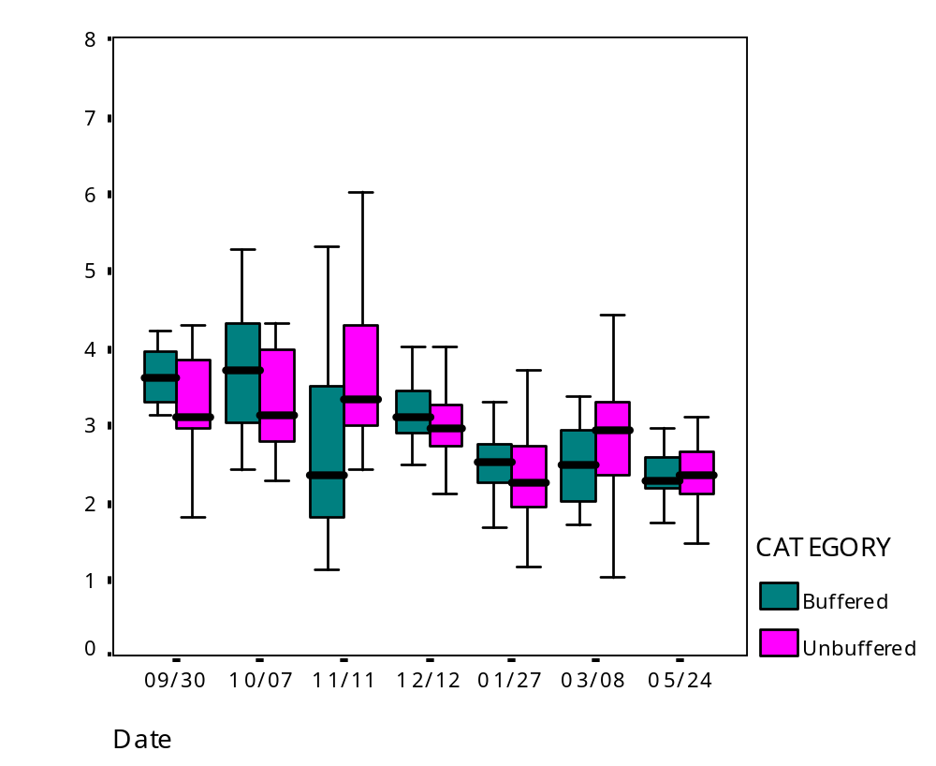
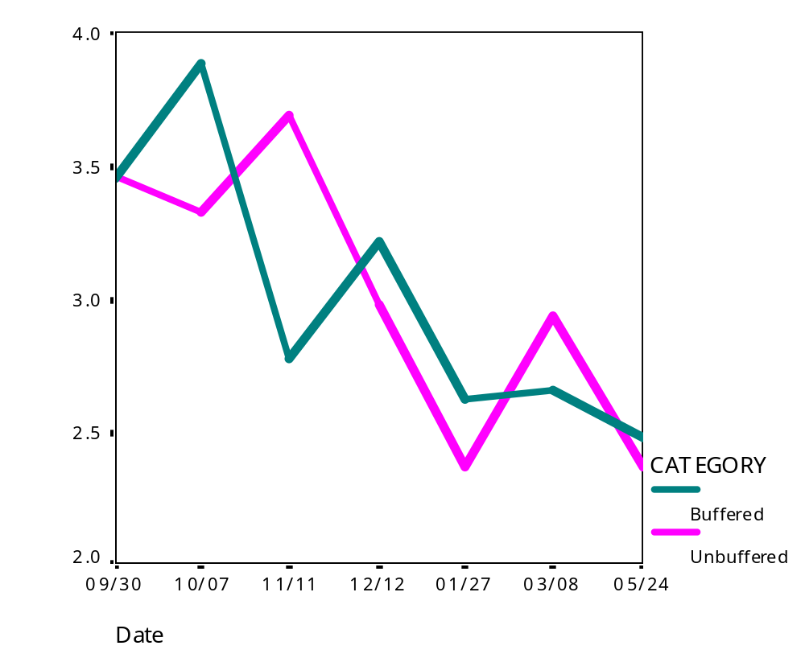
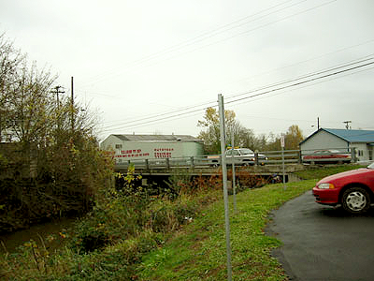
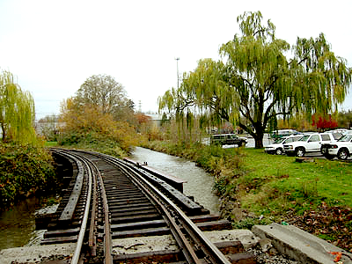
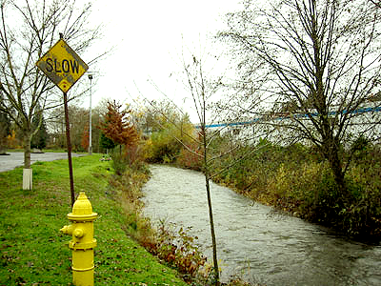
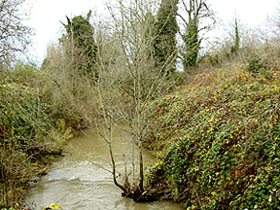
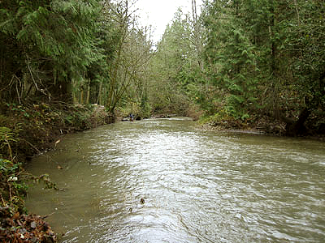
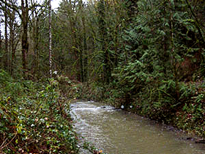
Effect of Riparian Vegetation on Trace Metal Concentrations in an Urban Stream
Rebecca M. Gloss and J. Alan Yeakley
Environmental Science and Resources, Portland State University, Portland, OR 97207-0751 USA
Abstract
Riparian vegetation buffers have been shown to reduce excess runoff of nutrients and sediments to streams (Line et al. 2002), but their function in preventing metal loading is poorly understood. In urban areas, where controlling heavy metals is the most important factor in improving surface water quality (Marsalek 1991), it is important to investigate the potential of these natural systems in preventing anthropogenic metal loading. We hypothesized that by reducing surface runoff, increasing the amount of organic matter with which metals can bind, and taking up metals directly, riparian zones may reduce the input of dissolved metals to streams. Johnson Creek flows through commercial, residential, industrial, and forested land uses in southeast Portland, OR, providing an opportunity for comparison between heavily vegetated and unbuffered sections. We installed shallow groundwater wells at 6 sites along Johnson Creek: 3 lined with less than 40m of vegetation and 3 with vegetation buffers at least 200m wide. From September until May, we collected weekly samples of the shallow groundwater and surface water at each site, and analyzed 7 weeks of those samples for zinc (Zn), copper (Cu), and lead (Pb) concentrations by inductively-coupled plasma mass spectrometry (ICPMS). We predicted that surface water dissolved metal concentrations would show a cumulative effect from the entire watershed, and thus would increase from upstream to downstream. We also predicted that concentrations in shallow groundwater would be representative of adjacent, small-scale land use (Sonoda et al. 2002), and would increase with decreasing adjacent riparian buffer width. Results show that metal concentrations at buffered and unbuffered sites were not significantly different for Zn, Cu and Pb. Shallow groundwater concentrations of Zn, Cu and Pb, however, were significantly higher than surface water concentrations (p<0.001). We conclude that the most important factor affecting metal concentrations was stream flow, and that local riparian buffer conditions did not exert significant control over local streamwater metal concentrations.
Figure 3. Comparison of metal concentrations for surface
and shallow ground water at buffered and unbuffered sites.
Zn reported as ln(concentration) in ppb. Cu and Pb reported as % of samples above detection limit.
Figure 5. Daily discharge of Johnson Creek during study period (USGS 2004). Arrows represent days for which concentrations were determined.
Figure 1. Location of Study Sites along Johnson Creek, Portland, OR. All sites lie within the Urban Growth Boundary.
Experimental Design
6 study sites: 3 with <40 m of vegetation, 3 with >200m
All sites at least 40 m downstream of pipes or outfalls
3 shallow groundwater wells per site, 60 cm below streambed in midstream
Collected surface water and shallow groundwater weekly from Sep 2003 to May 2004
Determined concentrations of Zn, Cu, and Pb using Inductively-Coupled Plasma Mass Spectrometry (ICPMS)
Measured effect of streamflow, buffer width, river mile, and antecedent precipitation
Figure 4b. Mean ln(Zn) as a function of precipitation on the day of sampling, for buffered and unbuffered sites.
Figure 4. Concentration of Zn (ppb) at buffered
and unbuffered sites, for both surface water and
shallow groundwater combined.
Conclusions
Sites along Johnson Creek with wide riparian buffers did not have significantly different Zn, Cu, or Pb concentrations than sites with very narrow riparian buffers.
Shallow groundwater metal concentrations were significantly greater than surface water concentrations.
Precipitation causes a flush of metals into the stream, followed by dilution. This process is “flashier” in unbuffered sites.
Rip-rap armoring the stream banks may function to disconnect existing riparian buffers from the stream. Pipe networks, though avoided as much as possible in the experimental design, may cause storm runoff to bypass riparian buffers, making them ineffective in reducing metal loading.
Objectives
Primary objective:
Determine if concentrations of zinc (Zn), copper (Cu), and lead (Pb) are higher in sections of an urban stream with little to no riparian vegetation (unbuffered sites) differed significantly from sections of the same stream that have wide riparian buffers.
Secondary objective:
Determine how stream flow affected metal concentrations at buffered and unbuffered sites.
References
Line DE, White NM, Osmond DL, Jennings GD, Mojonnier CB (2002). Pollutant export from various land uses in the Upper Neuse River Basin. Water Environment Research 74(1):100-108.
Marsalek J (1991). Pollutant loads in urban stormwater: review of methods for planning-level estimates. Water Resources Bulletin 27:283-291.
Sonoda K, Yeakley JA, Adams S (2002). Near-stream groundwater correlations with streamwater nutrient concentrations in an urbanizing watershed. In: J.F. Kelly, ed. Groundwater/Surface Water Interactions, American Water Resources Association, pp 67-72.
USGS Water Resources of Oregon (2004). Real-time data for USGS 14211400 Johnson Creek at Regner Road, at Gresham, OR. http://waterdata.usgs.gov/or/nwis/dv?
Figure 2. Study sites along Johnson Creek, Portland, OR. Top row shows sites
with little to no riparian buffer; bottom row shows heavily buffered sites.
Figure 5. Mean ln(Zn) by date, for buffered and unbuffered sites.

